Slide 1

Quantum Risk Analysis
An Introduction
Lecture 1/3

Slide 2
01
Introduction
02
Quantum Computers
03
Risk profiling
04
Credit risk analysis
05
Classical Methods of Risk Analysis
Quantum Risk Analysis
06
Quantum Risk Analysis
07
Applying the quantum algorithm
Design by PresentationGO.com
08
Sources of Error
09
Advantages of Quantum Risk Analysis
10
Conclusions

Slide 3
01
Introduction
02
Quantum Computers
In this lecture
03
Risk profiling
04
Credit risk analysis
Design by PresentationGO.com
05
Classical Methods of Risk Analysis

Slide 4
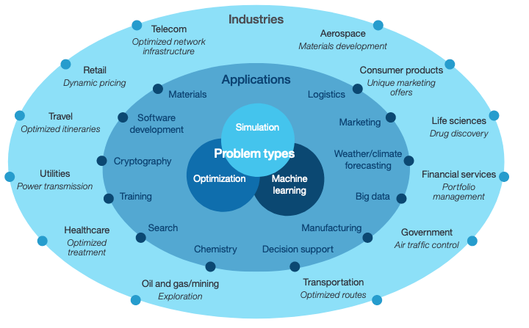
Introduction
https://www.investopedia.com/terms/f/financialrisk.asp
https://www.ibm.com/thought-leadership/institute-business-value/report/quantumleap
1

Slide 5
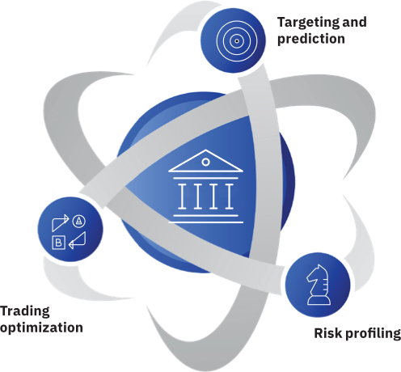
Quantum Computers
The Homeland Security Research Corporation (HSRC) has predicted the market for quantum computing will be more than $10 billion by 2024.
Quantum Computers enable us to present and solve large and complex problems that classical supercomputers cannot solve.
https://www.ibm.com/quantum-computing/what-is-quantum-computing/
https://www.ibm.com/thought-leadership/institute-business-value/report/quantumleap
2

Slide 6
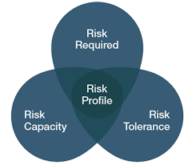
Risk Profiling
Calculating financial risk: Assessing the possibility of losing money from an investment or business venture.
Some Risk Metrics: Standard deviation, beta, VaR, CAPM
https://www.canaccordgenuity.com/wealth-management-australia/investment-management/your-risk-profile/
https://www.ibm.com/thought-leadership/institute-business-value/report/exploring-quantum-financial
3

Slide 7
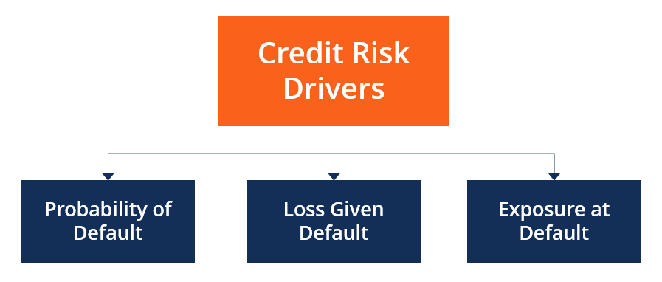
Credit Risk Analysis
Economic Capital Requirement: difference between VaR and expected value of given loss distribution.
https://corporatefinanceinstitute.com/resources/knowledge/credit/purpose-of-credit-risk-analysis/
https://arxiv.org/pdf/1907.03044.pdf
4

Slide 8
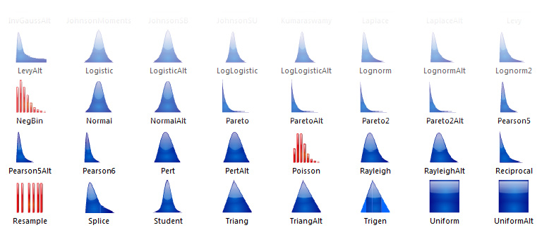
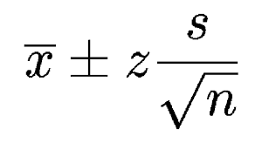
Classical Methods of Risk Analysis
Monte-Carlo Simulations
Confidence Interval calculation:
Common probability distributions
https://www.statisticshowto.com/probability-and-statistics/confidence-interval/
https://www.palisade.com/risk/monte_carlo_simulation.asp
5

Slide 9
06
Quantum Risk Analysis
In the next lecture…
07
Applying the quantum algorithm
Design by PresentationGO.com

